Slide 1

“DIABETES PREDICTION SYSYTEM” Submited By: GEETANSH VERMA 1729201 SAURABH KUMAR 1729218 SINDHUSUTA MOHANTY 1729222 ANSUMAN SAHOO 1729242
UNDER THE GUIDANCE OF
PROF. Dr. TANMOY MAITRA
SCHOOL OF COMPUTER ENGINEERING
KALINGA INSTITUTE OF INDUSTRIAL TECHNOLOGY
BHUBANESWAR, ODISHA - 751024 May 2020

Slide 2
Contents
1 Introduction
2 Literature Survey
3 Software Requirements Specification
4 Requirement Analysis
5 System Design
6 Improvements
7 System Testing
8 Project Planning
9 Implementation
10 Screenshots of Project
11 Conclusion and Future Scope
12 References

Slide 3
Introduction
Diabetes is considered as one of the deadliest and chronic diseases which causes an increase in blood sugar. Many complications occur if diabetes remains untreated and unidentified. The tedious identifying process results in visiting of a patient to a diagnostic center and consulting doctor. But the rise in machine learning approaches solves this critical problem.
The motive of this study is to design a model which can prognosticate the likelihood of diabetes in patients with maximum accuracy. Therefore six machine learning classification algorithms namely Decision Tree, KNN ,Logistic regrassion, Naive Bayes,Random Forest, Support Vector Machine are used in this experiment to detect diabetes at an early stage. Experiments are performed on Pima Indians Diabetes Database (PIDD) which is sourced from UCI machine learning repository.

Slide 4
Litrature survey
Orabi et al. in designed a system for diabetes prediction, whose main aim is the prediction of diabetes a candidate is suffering at a particular age. The proposed system is designed based on the concept of machine learning, by applying decision tree. Obtained results were satisfactory as the designed system works well in predicting the diabetes incidents at a particular age, with higher accuracy using Decision tree,
Pradhan et al in used Genetic programming (GP) for the training and testing of the database for prediction of diabetes by employing Diabetes data set which is sourced from UCI repository. Results achieved using Genetic Programming , gives optimal accuracy as compared to other implemented techniques. There can be significant improve in accuracy by taking less time for classifier generation. It proves to be useful for diabetes prediction at low cost.
Rashid et al. in designed a prediction model with two sub-modules to predict diabetes-chronic disease. ANN (Artificial Neural Network) is used in the first module and FBS (Fasting Blood Sugar) is used in the second module. Decision Tree is used to detect the symptoms of diabetes on patients health.
Nongyao et al. in applied an algorithm which classifies the risk of diabetes mellitus. To fulfill the objective au- thor has employed four following renowned machine learning classification methods namely Decision Tree, Artificial Neural Networks, Logistic Regression and Naive Bayes. For improving the robustness of designed model Bagging and Boosting techniques are used.

Slide 5
Software Requirements Specification
System Requirement
Operating system:- Linux or Windows 10
RAM requirement:- 8 GB.
ROM:-256 GB
System Type:- 64-bit Operating System
x-64 based processor
Processor:-Intel® Core™ i5-7200 CPU 2.50GHz 2.71GHz
To obtain efficient results, more computational power is favourable .
Technical Requirements
* Python3
* PyCharm
* Jupyter Notebook
* Spyder
Libraries Requirement:
Pandas:
Matplotlib:
NumPy
Scikit-learn
Tkinter (GUI)

Slide 6

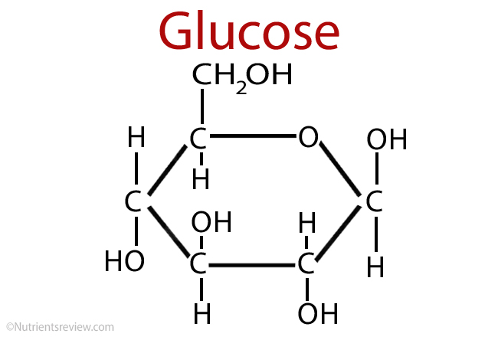


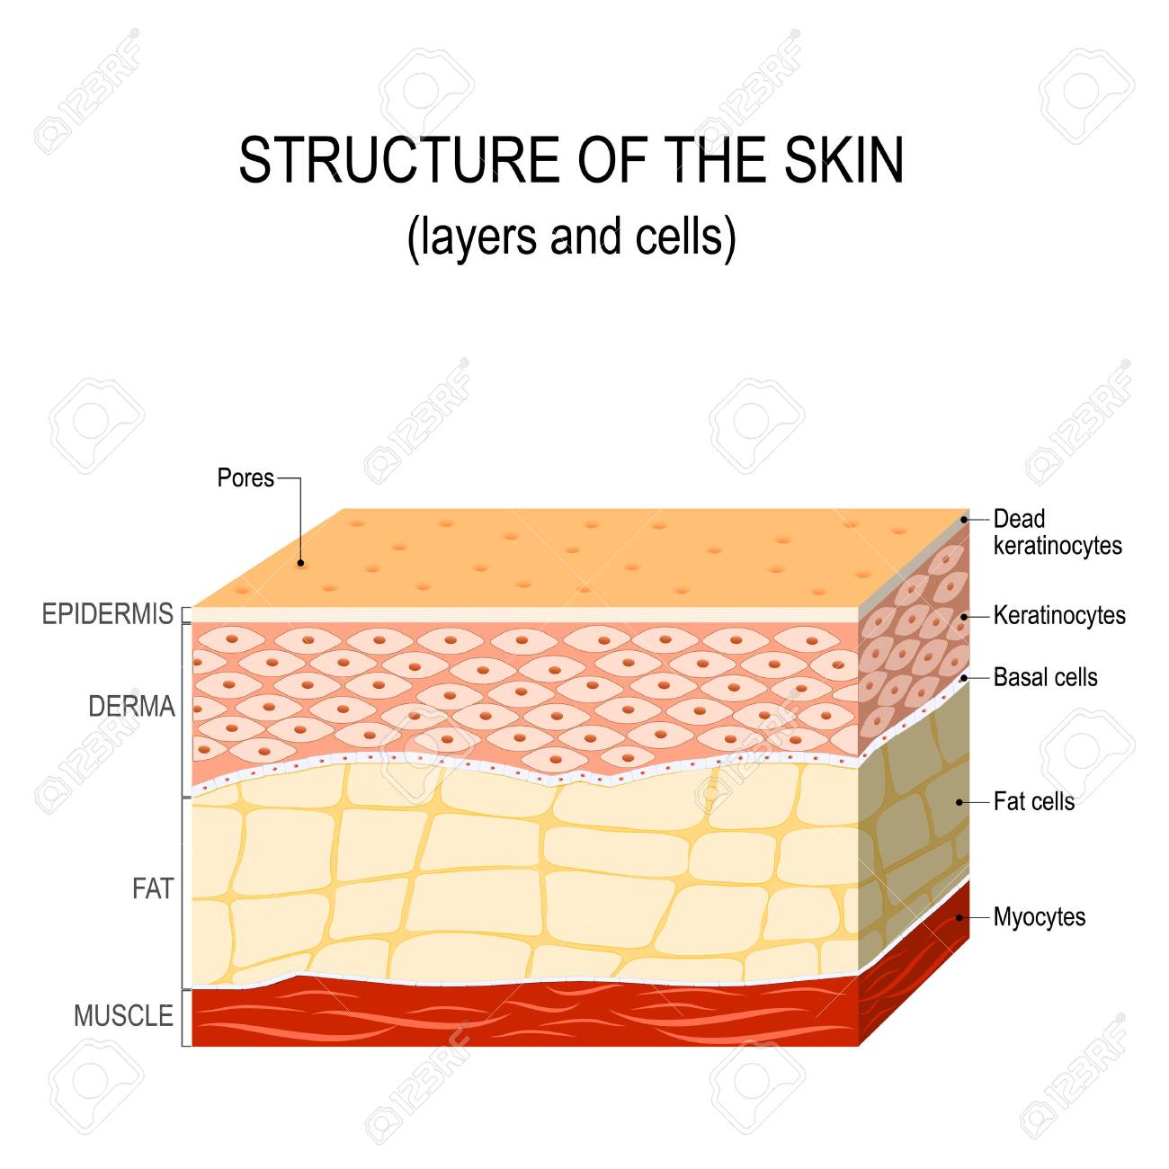

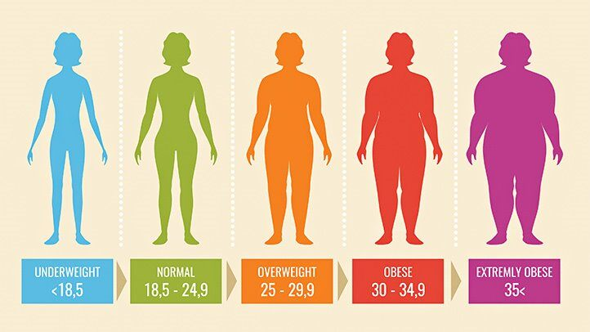
Parameter
+ + +
+ +
= RESULT

Slide 7
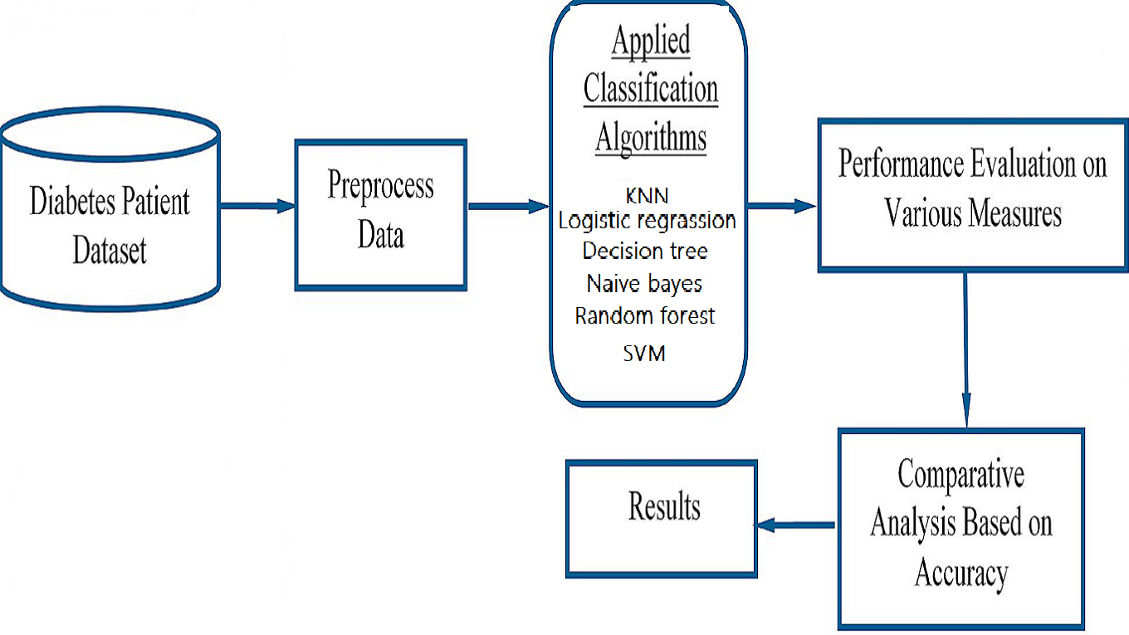
Dataflow Diagram

Slide 8
IMPROVEMENT
Implemented two new algorithim Random Forest and SVM
Rather than default value we used best hyper parametrs value for better accuracy of our model.
Successfully got the best n_neighbors value for KNN algorithim
Got a best algorithim for our model
As SVM is giving 82% ,we decided to predict our result using SVM
Necessary changes done over the GUI for better experience
Added two more button for new algorithim and sucessfully bind our codes with predict button.

Slide 9
How the system works
To perform the experimentation Pima Indians Diabetes Dataset has been used.The dataset contains 8 attributes and 1 class variable .This data set contains total 768 diabetic and non-diabetic women records whose age is above 21 years.Class variable (0 or 1).0-It indicates False Diabetic Test and1-It indicates True Diabetic Test .First we load the dataset as a CSV file and identify each column then process the dataset by finding a mean value and perform some cleaning operation.Divided the whole data into 7:3 for train and test respectively.
Train and test of dataset done over the all six algorithm i.e DESCISION TREE,KNN,LOGISTIC REGRASSION and NAIVE BAYES,Ranom Forest and SVM . From the testing part we analyze the performance of each and every algorithm in percent .Most of the case we got Support Vectror Machine gives us the highest accuracy as compared to other so finally we deecided to pick it.
Finally it provides a interface to the user ,where a user has to provide the value of the parameter that she has and our machine will take that value and start the process from the algorithm comparison and use that which has maximum accuracy . Input data will take to test and provides the best possible output.
We are also trying to test some other algorithm in future so that our machine can perform more accurately and achieve the goal of system.

Slide 10
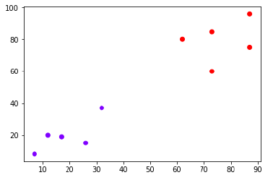
Algorithms Used:
K-Nearest Neighbor(KNN):
KNN is known as a instance-based learning, or also popular as a lazy learning, where the role is only estimated locally and all calculation is postponed until classification. It studies all existing cases and classifies into new cases based on common factor. (e.g., distance functions). The neighbors are taken from a set of objects for which the object property value (for k-NN regression) or the classes (for kNN classification) are recognized. This can be supposed of as the training set for the algorithm, though no explicit training step is essential. Significance of k is constantly a positive integer. Here neighbors are selected from set of objects so constantly accurate classification is recognized.
.

Slide 11
Hyper parameter optimization of knn
Before hyper parameter optimization ,accuracy was 71%
after hyper parameter optimization by gridSearchCv algorithm,accuracy is 75%
Previously the accuracy was 71% because of by default hyper parameters value.
but after using the gridSearchCv ,our parameters like n-neighbours,leaf-size,weights,algorithm,n_jobs, we are able to increase our accuracy.
GridSearchCV-GridSearchCV is a function that comes in Scikit-learn’s(or SK-learn) model_selection package.
This function helps to loop through predefined hyperparameters and fit our model on our training set.
So, in the end, we can select the best parameters from the listed hyperparameters.
HyperParameters Explaned:
1.n_neighbors:int, default=5
Number of neighbors to use by default for kneighbors queries.
2.leaf_size:int, default=30
Leaf size passed to BallTree or KDTree.
This can affect the speed of the construction and query, as well as the memory required to store the tree.
The optimal value depends on the nature of the problem.

Slide 12
Continue...
3.weights:{‘uniform’, ‘distance’} or callable, default=’uniform’
weight function used in prediction. Possible values:
‘uniform’ : uniform weights. All points in each neighborhood are weighted equally.
‘distance’ : weight points by the inverse of their distance.
in this case, closer neighbors of a query point will have a greater influence than neighbors which are further away.
[callable] : a user-defined function which accepts an array of distances, and returns an array of the same shape containing the weights.
4.algorithm:{‘auto’, ‘ball_tree’, ‘kd_tree’, ‘brute’}, default=’auto’
Algorithm used to compute the nearest neighbors:
‘ball_tree’ will use BallTree
‘kd_tree’ will use KDTree
‘brute’ will use a brute-force search.
‘auto’ will attempt to decide the most appropriate algorithm based on the values passed to fit method.
5.n_jobs:int, default=None
This parameter tells the engine how many processors is it allowed to use.
A value of “-1” means there is no restriction whereas a value of “1” means it can only use one processor.

Slide 13
Continue...
6.param_grid:dict or list of dictionaries
Dictionary with parameters names (str) as keys and lists of parameter settings to try as values, or a list of such dictionaries, in which case the grids spanned by each dictionary in the list are explored.
This enables searching over any sequence of parameter settings.
7.best_params_dict
Parameter setting that gave the best results on the hold out data.
Finally,by gridSearchCv algorithm,we got the best hyper parameter combination as
{'algorithm': 'auto', 'leaf_size': 1, 'n_jobs': -1, 'n_neighbors': 8, 'weights': 'uniform'}

Slide 14
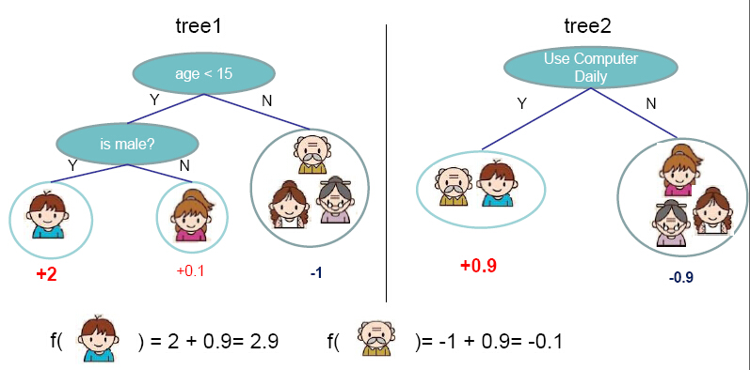
Decision Tree:
A decision tree is a flowchart-like structure in which each internal node represents a "test" on an attribute (e.g. whether a coin flip comes up heads or tails), each branch represents the outcome of the test, and each leaf node represents a class label (decision taken after computing all attributes).In decision analysis, a decision tree and the closely related influence diagram are used as a visual and analytical decision support tool, where the expected values (or expected utility) of competing alternatives are calculated.
A decision tree consists of three types of nodes:
1. Decision nodes – typically represented by squares
2. Chance nodes – typically represented by circles
3. End nodes – typically represented by triangles

Slide 15
Hyperparameter Tuning of Decision Tree
Before hyper parameter optimization ,accuracy was 70%
after hyper parameter optimization by gridSearchCv algorithm,accuracy is 73%
Previously the accuracy was 70% because of by default hyper parameters value.
but after using the gridSearchCv ,our parameters like max_features,min_samples_leaf,min_samples_split, we are able to increase our accuracy.
GridSearchCV
GridSearchCV is a function that comes in Scikit-learn’s(or SK-learn) model_selection package.
This function helps to loop through predefined hyperparameters and fit our model on our training set.
So, in the end, we can select the best parameters from the listed hyperparameters.

Slide 16
HyperParameters Explained:
1.max_features:int, float or {“auto”, “sqrt”, “log2”}, default=None
The number of features to consider when looking for the best split:
If int, then consider max_features features at each split.
If float, then max_features is a fraction and int(max_features * n_features) features are considered at each split.
If “auto”, then max_features=sqrt(n_features).
If “sqrt”, then max_features=sqrt(n_features).
If “log2”, then max_features=log2(n_features).
If None, then max_features=n_features.
2.min_samples_leaf:int or float, default=1
Leaf is the end node of a decision tree.
A smaller leaf makes the model more prone to capturing noise in train data.
Generally we prefer a minimum leaf size of more than 50.
If int, then consider min_samples_leaf as the minimum number.
If float, then min_samples_leaf is a fraction and ceil(min_samples_leaf * n_samples) are the minimum number of samples for each node.

Slide 17
Continue....
3.min_samples_split:int or float, default=2
The minimum number of samples required to split an internal node:
If int, then consider min_samples_split as the minimum number.
If float, then min_samples_split is a fraction and ceil(min_samples_split * n_samples) are the minimum number of samples for each split.
4.random_state:int, RandomState instance or None, default=None
Controls the randomness of the estimator.
The features are always randomly permuted at each split, even if splitter is set to "best".
When max_features < n_features, the algorithm will select max_features at random at each split before finding the best split among them.
But the best found split may vary across different runs, even if max_features=n_features.
That is the case, if the improvement of the criterion is identical for several splits and one split has to be selected at random.
To obtain a deterministic behaviour during fitting, random_state has to be fixed to an integer.
5.param_grid:dict or list of dictionaries
Dictionary with parameters names (str) as keys and lists of parameter settings to try as values, or a list of such dictionaries, in which case the grids spanned by each dictionary in the list are explored.
This enables searching over any sequence of parameter settings.
Finally,by gridSearchCv algorithm,we got the best hyper parameter combination as
Best Hyper Parameters: {'max_features': 'auto', 'min_samples_leaf': 11, 'min_samples_split': 2, 'random_state': 123}

Slide 18
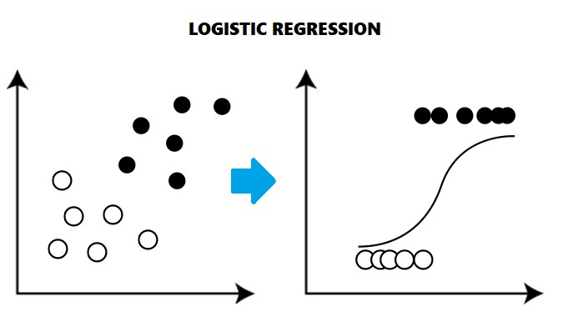
Logistic regression:
The binary logistic regression model has extensions to more than two levels of the dependent variable: categorical outputs with more than two values are modeled by multinomial logistic regression, and if the multiple categories are ordered, by ordinal logistic regression, for example the proportional odds ordinal logistic model. The model itself simply models probability of output in terms of input, and does not perform statistical classification (it is not a classifier), though it can be used to make a classifier, for instance by choosing a cutoff value and classifying inputs with probability greater than the cutoff as one class, below the cutoff as the other

Slide 19
Hyperparameter Tuning of Logistic Regression
Before hyper parameter optimization ,accuracy was 76%
after hyper parameter optimization by gridSearchCv algorithm,accuracy is 81%
Previously the accuracy was 76% because of by default hyper parameters value.
but after using the gridSearchCv ,our parameters like C,max_iter,penalty and solver ,we are able to increase our accuracy.
GridSearchCV
GridSearchCV is a function that comes in Scikit-learn’s(or SK-learn) model_selection package.
This function helps to loop through predefined hyperparameters and fit our model on our training set.
So, in the end, we can select the best parameters from the listed hyperparameters.

Slide 20
Hyperparameters Exaplained:
1.C:Float,default=1.0
Inverse regularization parameter - A control variable that retains strength modification of Regularization by being inversely positioned to the Lambda regulator.
It’s a penalty term, meant to disincentivize and regulate against Overfitting.
It basically means - the amount of variables that are not being constricted and controlled - in the regularization process of the Regression.
The parameter C is the the inverse of regularization strength in Logistic Regression.
Regularization is applying a penalty to increasing the magnitude of parameter values in order to reduce overfitting.
When you train a model such as a logistic regression model, you are choosing parameters that give you the best fit to the data.
This means minimizing the error between what the model predicts for your dependent variable given your data compared to what your dependent variable actually is.
The problem comes when you have a lot of parameters (a lot of independent variables) but not too much data,so we have used C parameter.

Slide 21
Continue..
2.max_iter:int, default=100
Maximum number of iterations taken for the solvers to converge.
3.penalty{‘l1’, ‘l2’, ‘elasticnet’, ‘none’}, default=’l2’
Used to specify the norm used in the penalization.
The ‘newton-cg’, ‘sag’ and ‘lbfgs’ solvers support only l2 penalties.
‘elasticnet’ is only supported by the ‘saga’ solver.
If ‘none’ (not supported by the liblinear solver), no regularization is applied.
4.solver:{‘newton-cg’, ‘lbfgs’, ‘liblinear’, ‘sag’, ‘saga’}, default=’lbfgs’
Algorithm to use in the optimization problem.
For small datasets, ‘liblinear’ is a good choice, whereas ‘sag’ and ‘saga’ are faster for large ones.
‘newton-cg’, ‘lbfgs’, ‘sag’ and ‘saga’ handle L2 or no penalty
‘liblinear’ and ‘saga’ also handle L1 penalty
‘saga’ also supports ‘elasticnet’ penalty
‘liblinear’ does not support setting penalty='none'

Slide 22
Continue...
5.param_grid:dict or list of dictionaries
Dictionary with parameters names (str) as keys and lists of parameter settings to try as values, or a list of such dictionaries, in which case the grids spanned by each dictionary in the list are explored.
This enables searching over any sequence of parameter settings.
Finally,by gridSearchCv algorithm,we got the best hyper parameter combination as
Best Hyper Parameters: {'C': 10, 'max_iter': 100, 'penalty': 'l2', 'solver': 'newton-cg'}

Slide 23
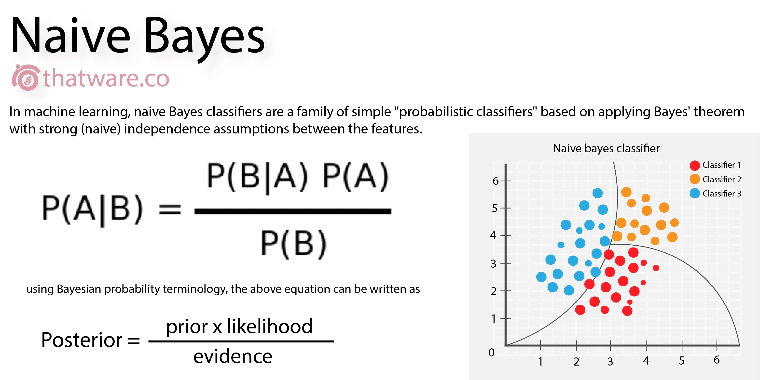
NAIVE BAYES :
Naive Bayes classifier is a straightforward and powerful algorithm for the classification task. Even if we are working on a data set with millions of records with some attributes, it is suggested to try Naive Bayes approach. Naive Bayes classifier gives great results when we use it for textual data analysis. Such as Natural Language Processing.

Slide 24
Hyperparameter Tuning of Naive Bayes
Before hyper parameter optimization ,accuracy was 61%
after hyper parameter optimization by gridSearchCv algorithm,accuracy is 65%
Previously the accuracy was 61% because of by default hyper parameters value.
but after using the gridSearchCv ,our parameters like alpha ,we are able to increase our accuracy.
GridSearchCV
GridSearchCV is a function that comes in Scikit-learn’s(or SK-learn) model_selection package.
This function helps to loop through predefined hyperparameters and fit our model on our training set.
So, in the end, we can select the best parameters from the listed hyperparameters.

Slide 25
Hyper parameters Explained:
1.apha:float, default=1.0
Additive (Laplace/Lidstone) smoothing parameter (0 for no smoothing).
the alpha parameter is what is known as a hyperparameter; i.e. a parameter that controls the form of the model itself.
In most cases, the best way to determine optimal values for hyperparameters is through a grid search over possible parameter values,
using cross validation to evaluate the performance of the model on your data at each value.
2.param_grid:dict or list of dictionaries
Dictionary with parameters names (str) as keys and lists of parameter settings to try as values, or a list of such dictionaries, in which case the grids spanned by each dictionary in the list are explored.
This enables searching over any sequence of parameter settings.
3.best_params_dict
Parameter setting that gave the best results on the hold out data.
Finally,by gridSearchCv algorithm,we got the best hyper parameter combination as
{'alpha': 10.0}

Slide 26
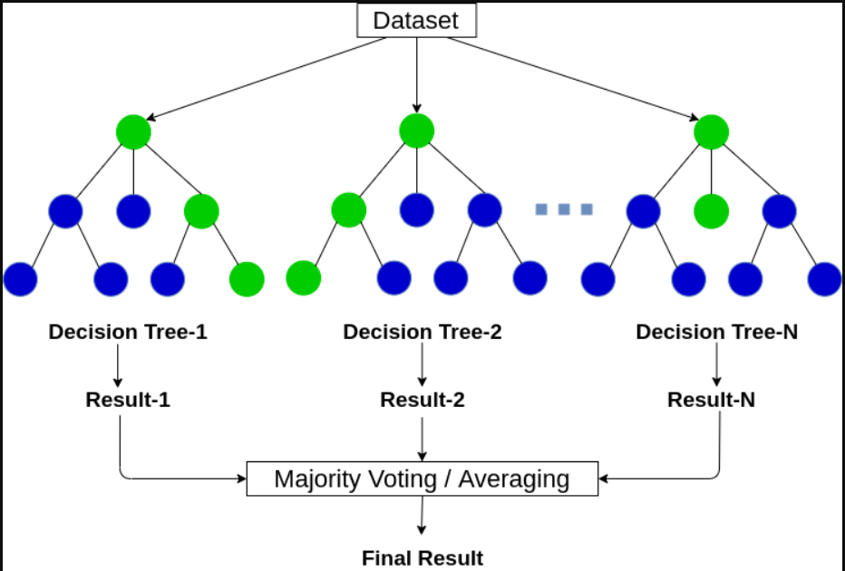
Random Forest
Random forests or random decision forests are an ensemble learning method for classification, regression and other tasks that operate by constructing a multitude of decision trees at training time and outputting the class that is the mode of the classes or mean/average prediction of the individual trees.

Slide 27
Hyperparameter Tuning for Random Forest
Before hyper parameter optimization ,accuracy was 79%
after hyper parameter optimization by gridSearchCv algorithm,accuracy is 81%
Previously the accuracy was 79% because of default hyper parameters value.
Hyperparameters Exaplained:
1.Criterion:['gini','entropy']
The criteria with which to split on each node (Gini or Entropy for a classification task, or the MSE or MAE for regression)
2.n_estimators:
This is the number of trees you want to build before taking the maximum voting or averages of predictions.
Higher number of trees give you better performance but makes your code slower.
We should choose as high value as your processor can handle because this makes your predictions stronger and more stable.

Slide 28
Continue..
3.min_samples_leaf:int or float,default:1
Leaf is the end node of a decision tree.
A smaller leaf makes the model more prone to capturing noise in train data.
Generally we prefer a minimum leaf size of more than 50.
If int, then consider min_samples_leaf as the minimum number.
If float, then min_samples_leaf is a fraction and ceil(min_samples_leaf * n_samples) are the minimum number of samples for each node.
4.min_samples_split:int or float, default=2
The minimum number of samples required to split an internal node:
If int, then consider min_samples_split as the minimum number.
If float, then min_samples_split is a fraction and ceil(min_samples_split * n_samples) are the minimum number of samples for each split.
5.n_jobs :
This parameter tells the engine how many processors is it allowed to use.
A value of “-1” means there is no restriction whereas a value of “1” means it can only use one processor.

Slide 29
Continue..
6.param_grid:dict or list of dictionaries
Dictionary with parameters names (str) as keys and lists of parameter settings to try as values, or a list of such dictionaries, in which case the grids spanned by each dictionary in the list are explored.
This enables searching over any sequence of parameter settings.
7.best_params_dict
Parameter setting that gave the best results on the hold out data.
Finally,by gridSearchCv algorithm,we got the best hyper parameter combination as
{'criterion': 'gini', 'min_samples_leaf': 3, 'min_samples_split': 3, 'n_estimators': 25, 'n_jobs': -1}

Slide 30
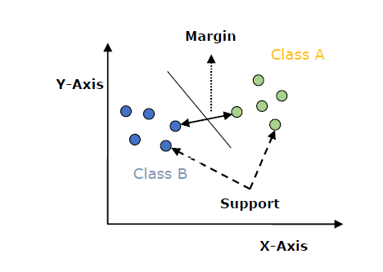
Support Vector Machine
Support vector machines (SVMs) are powerful yet flexible supervised machine learning algorithms which are used both for classification and regression
The main goal of SVM is to divide the datasets into classes to find a maximum marginal hyperplane (MMH) and it can be done in the following two steps −
First, SVM will generate hyperplanes iteratively that segregates the classes in best way.
Then, it will choose the hyperplane that separates the classes correctly.
SVM uses a technique called the kernel trick in which kernel takes a low dimensional input space and transforms it into a higher dimensional space. In simple words, kernel converts non-separable problems into separable problems by adding more dimensions to it. It makes SVM more powerful, flexible and accurate

Slide 31
Hyperparameter Tuning of SVM
Before hyper parameter optimization ,accuracy was 81%
after hyper parameter optimization by gridSearchCv algorithm,accuracy is 86%
Previously the accuracy was 81% because of by default hyper parameters value.
but after using the gridSearchCv ,our parameters like C and kernel,we are able to increase our accuracy.
GridSearchCV
GridSearchCV is a function that comes in Scikit-learn’s(or SK-learn) model_selection package.
This function helps to loop through predefined hyperparameters and fit our model on our training set.
So, in the end, we can select the best parameters from the listed hyperparameters.

Slide 32
Hyperparameters Explained:
1.C:Float,default=1.0
Inverse regularization parameter - A control variable that retains strength modification of Regularization by being inversely positioned to the Lambda regulator.
It’s a penalty term, meant to disincentivize and regulate against Overfitting.
It basically means - the amount of variables that are not being constricted and controlled - in the regularization process of the Regression.
The parameter C is the the inverse of regularization strength in Logistic Regression.
Regularization is applying a penalty to increasing the magnitude of parameter values in order to reduce overfitting.
When you train a model such as a logistic regression model, you are choosing parameters that give you the best fit to the data.
This means minimizing the error between what the model predicts for your dependent variable given your data compared to what your dependent variable actually is.
The problem comes when you have a lot of parameters (a lot of independent variables) but not too much data,so we have used C parameter.

Slide 33
Continue...
2.Kernel:
The main function of the kernel is to take low dimensional input space and transform it into a higher-dimensional space.
It is mostly useful in non-linear separation problem.
3.param_grid:dict or list of dictionaries
Dictionary with parameters names (str) as keys and lists of parameter settings to try as values, or a list of such dictionaries, in which case the grids spanned by each dictionary in the list are explored.
This enables searching over any sequence of parameter settings.
4.best_params_dict
Parameter setting that gave the best results on the hold out data.
Finally,by gridSearchCv algorithm,we got the best hyper parameter combination as
Best Hyper Parameters:
{'C': 6, 'kernel': 'linear'}

Slide 34
System Testing
Test | Test Case Title | Test Condition | System Behavior | Expected Result
ID
T01 | Pregnant=2 Glucose=200 Blood pressure=140 Skin=19 Insulin=140 Body mass index=23 Pedigree=1 Age=34 | After comparison SVM is found to have highest accuracy.Therefore here SVM has being used | Knn-78.0% Decision tree71.0% Naive bayes79.0% Random Forest-81% Logistic regression-80% SVM -86% | You have no diabetes (0)
T02 | Pregnant=4 Glucose=187 Blood pressure=110 Skin=17 Insulin=47 Body mass index=18 Pedigree=2 Age=25 | After comparison SVM is found to have highest accuracy.Therefore here SVM has being used | Knn-78.0% Decision tree71.0% Naive bayes-79.0% Logistic regression-80% Random Forest-81% SVM-86% | You haveDiabetes or may get soon (1)
The validity of program was checked by
inserting various input parameters and
based upon the input the system does the
classification into:
Person will have diabetes
or Will not have diabetes in future.

Slide 35
Implementation
Collect the dataset
Load the dataset
Describe the dataset
Analysis of the dataset for cleaning purpose
Split the dataset for training and testing
Train the dataset using algorithms
Compare the accuracy of all the Algorithm
Create GUI for the model

Slide 36
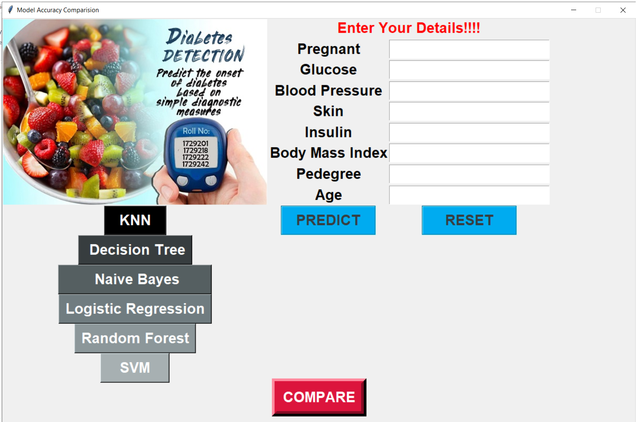
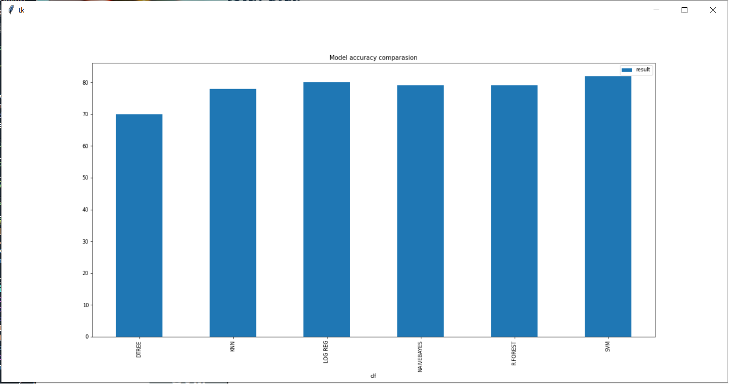
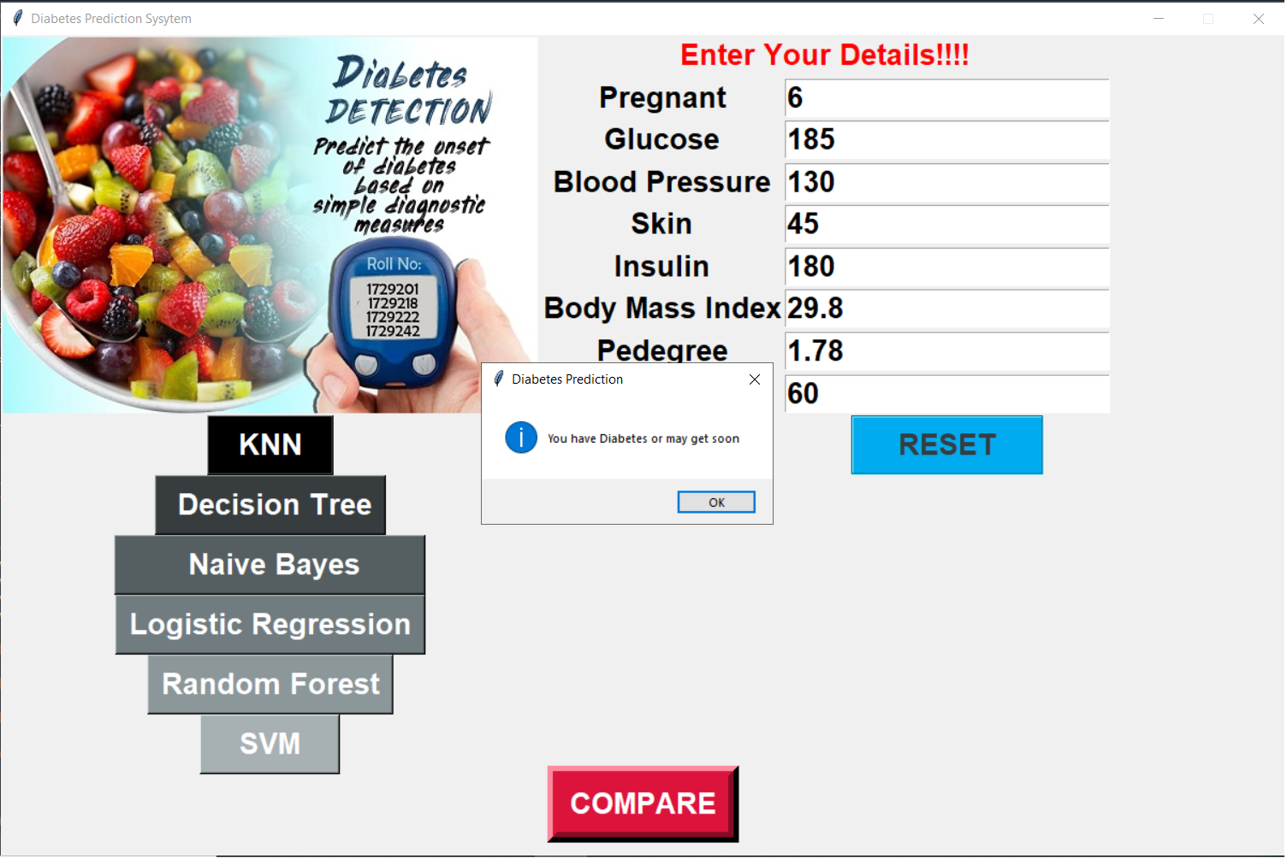
Projects screenshot

Slide 37
COCLUSION AND FUTURE SCOPE
FUTURE SCOPE
We tried and optimize every algorithm and we found out SVM algorithm best suitable for over application.
But this is just not the end. We can also implement other classification algorithms to obtain more accurate and optimized result.
CONCLUSION
Machine learning algorithms in the medical field extracts different hidden patterns from the medical data. They can be used for the analysis of important clinical parameters, prediction of various diseases, forecasting tasks in medicine, extraction of medical knowledge, therapy planning support and patient management. A number of algorithms were proposed for the prediction and diagnosis of diabetes. These algorithms provide more accuracy than the available traditional systems. We tried and optimize every algorithm and we found out SVM algorithm best suitable for over application.

Slide 38
REFERENCES
1.UCI Machine Learning Repository- Center for Machine Learning and Intelligent System, http://archive.ics.uci.edu/ml/
2.Gaganjot Kaur, Amit Chhabra, “Improved J48 Classification Algorithm for the Prediction of Diabetes”, International Journal of Computer Applications (0975 – 8887) Volume 98 – No.22, July 2014.
3.Machine Learning tutorials and examples https://www.toptal.com/machine-learning/machine- learningtheory- an-introductory-primer .
4.Sudip Mandal, Goutam Saha, Rajat K. Pal, “A Comparative Study on Disease Classification using Different Soft Computing Techniques”, The SIJ Transactions on Computer Science Engineering & its Applications (CSEA), Vol. 2, No. 3, May 2014.
5.https://scikit-learn.org/stable/modules/generated/sklearn.ensemble.RandomForestClassifier.html
6.https://scikit-learn.org/stable/modules/svm.html
7.http://www.diabetes.org/diabetes-basics/type
8.https://scikit-learn.org/stable/modules/neighbors.html

